Slide 1
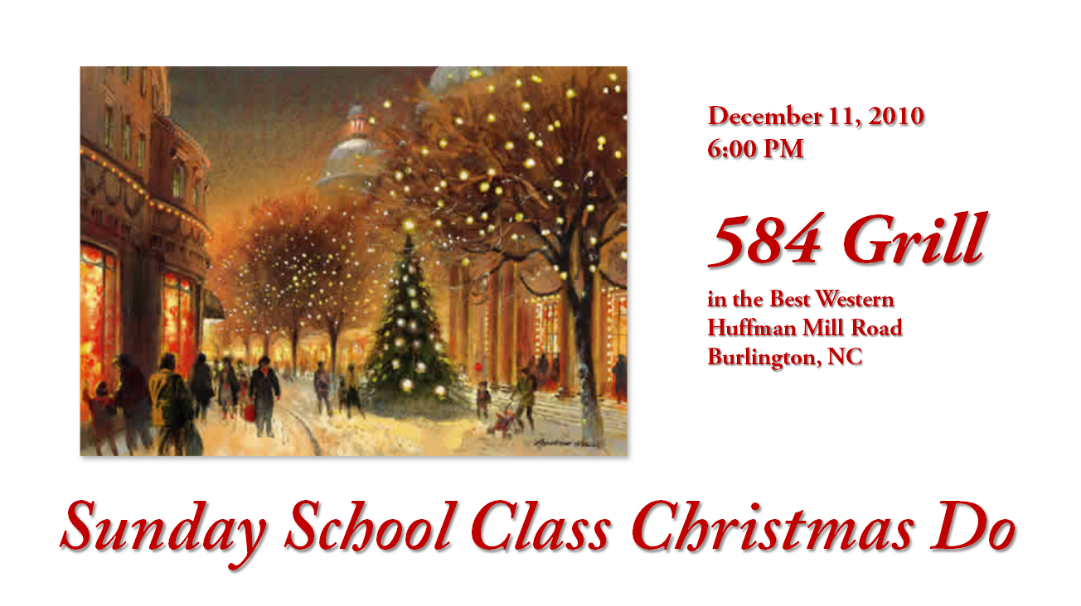

Slide 2
Understanding The Bible
The Purpose of the Bible
The Land of the Bible
The Story of the Bible – Old Testament
The Story of the Bible – New Testament
The Message of the Bible
The Authority of the Bible
The Interpretation of the Bible
The Use of the Bible
Today: Introduction ~ Worship
November 21: The Word software demonstration
November 28: Repentance & faith ~ Obedience ~ Witness
__________________________________________________________________________________________________________________________________
ALL WORD NOTES AND POWERPOINT PRESENTATIONS ARE AVAILABLE AT www.BethlehemChristian.org/bible

Slide 3
Uses Of The Bible
FOR MEDITATION Ps. 119:97-99 "O how I love the law! It is my meditation all the day...I have more understanding than all my teachers: for thy testimonies are my meditation."
FOR ADMONITION 1 Cor. 10:11 "Now all these things ...are written for our admonition."
FOR LIGHT Ps. 119:105, 130 "the word is a lamp unto my feet, and a light unto my path." "The entrance of thy words giveth light; it giveth understanding unto the simple."
FOR CLEANSING Ps. 119:9 "Wherewithal shall a young man cleanse his way? by taking heed thereto according to thy word."
FOR JOY Ps. 119:14, 24, 116 "I have rejoiced in the way of thy testimonies, as much as in all riches." "Thy testimonies also are my delight." " I rejoice at thy word."
FOR STRENGTH Ps. 119:28 "My soul melteth for heaviness: strengthen thou me according unto thy word."
FOR TRUST Ps. 119:42 "So shall I have wherewith to answer him that reproacheth me: for I trust in thy word."
FOR PEACE Ps. 119:165 "Great peace have thy which love thy law; and nothing shall offend them."
FOR BELIEF John 20:31 "But these are written, that ye might believe."
FOR INSTRUCTION 2 Tim. 3:16 "All scripture is given by inspiration of God, and is profitable for doctrine, for reproof, for correction, for instruction in righteousness."

Slide 4
The Bible is not a historic relic whose proper home is a museum. It is a “lamp” to our feet and a “light” to our path:
Your word is a lamp for my feet, a light on my path. Ps. 119:105
The Bible should be our “counselors” in all the trials of our day to day life.
Your statutes are my delight; they are my counselors.
Ps.119:24

Slide 5
So, as the Holy Spirit says:
“Today, if you hear his voice, ⁸ do not harden your hearts as you did in the rebellion, during the time of testing in the wilderness
But encourage one another daily, as long as it is called “Today,” so that none of you may be hardened by sin’s deceitfulness. Heb. 3:7-8, 13

Slide 6
Stott says that in the end there are only two possible responses to God’s Word, receive it or reject it.
Those who receive it are described:
They “tremble” at it, just because it is the Word of the great God himself. Isa. 66:2, 5; Ezra 9:4
They prize it like gold and relish it like honey. Ps. 19:10; 119:103,127
They rejoice over it “like one who finds great spoil.”
They thirst for it with the ardor of a suckled child. Ps. 119:162; 1 Pet. 2:2
Those who reject God’s Word are described:
To have closed their ears and refused to listen.
They are “stiff-necked” and follow “the stubbornness of {their} evil heart.” Jer. 17:23; 18:12; 19:15

Slide 7
The king sent Jehudi to get the scroll, and Jehudi brought it from the room of Elishama the secretary and read it to the king and all the officials standing beside him. ²² It was the ninth month and the king was sitting in the winter apartment, with a fire burning in the firepot in front of him. ²³ Whenever Jehudi had read three or four columns of the scroll, the king cut them off with a scribe’s knife and threw them into the firepot, until the entire scroll was burned in the fire.
Jer. 36:21-23

Slide 8
While a large crowd was gathering and people were coming to Jesus from town after town, he told this parable: ⁵ “A farmer went out to sow his seed. As he was scattering the seed, some fell along the path; it was trampled on, and the birds ate it up. ⁶ Some fell on rocky ground, and when it came up, the plants withered because they had no moisture. ⁷ Other seed fell among thorns, which grew up with it and choked the plants. ⁸ Still other seed fell on good soil. It came up and yielded a crop, a hundred times more than was sown.”
When he said this, he called out, “Whoever has ears to hear, let them hear.” Luke 8:4-8
“If anyone hears my words but does not keep them, I do not judge that person. For I did not come to judge the world, but to save the world. ⁴⁸ There is a judge for the one who rejects me and does not accept my words; the very words I have spoken will condemn them at the last day. John 12:47-48
²⁴ “Therefore everyone who hears these words of mine and puts them into practice is like a wise man who built his house on the rock. ²⁵ The rain came down, the streams rose, and the winds blew and beat against that house; yet it did not fall, because it had its foundation on the rock. ²⁶ But everyone who hears these words of mine and does not put them into practice is like a foolish man who built his house on sand. ²⁷ The rain came down, the streams rose, and the winds blew and beat against that house, and it fell with a great crash.” Matt. 7:24-27

Slide 9
While a large crowd was gathering and people were coming to Jesus from town after town, he told this parable: ⁵ “A farmer went out to sow his seed. As he was scattering the seed, some fell along the path; it was trampled on, and the birds ate it up. ⁶ Some fell on rocky ground, and when it came up, the plants withered because they had no moisture. ⁷ Other seed fell among thorns, which grew up with it and choked the plants. ⁸ Still other seed fell on good soil. It came up and yielded a crop, a hundred times more than was sown.”
When he said this, he called out, “Whoever has ears to hear, let them hear.” Luke 8:4-8
“If anyone hears my words but does not keep them, I do not judge that person. For I did not come to judge the world, but to save the world. ⁴⁸ There is a judge for the one who rejects me and does not accept my words; the very words I have spoken will condemn them at the last day. John 12:47-48
²⁴ “Therefore everyone who hears these words of mine and puts them into practice is like a wise man who built his house on the rock. ²⁵ The rain came down, the streams rose, and the winds blew and beat against that house; yet it did not fall, because it had its foundation on the rock. ²⁶ But everyone who hears these words of mine and does not put them into practice is like a foolish man who built his house on sand. ²⁷ The rain came down, the streams rose, and the winds blew and beat against that house, and it fell with a great crash.” Matt. 7:24-27

Slide 10
Stott believes we have to recover the lost art of meditation. We have to heed Jesus’ exhortation:
“Let these words sink into your ears.”
Luke 9:44
Keep this Book of the Law always on your lips; meditate on it day and night, so that you may be careful to do everything written in it. Then you will be prosperous and successful.
Josh. 1:8

Slide 11
Listening to God’s voice in and through his Word is only the beginning. It is not enough to “know these things,” Jesus said; we shall be blessed only if we “do them.”
Now that you know these things, you will be blessed if you do them. John 13:17
According to the New Testament the truth is something to be “done,” not merely “known”. No apostle put this more clearly than James, Jesus’ brother, who wrote:
Do not merely listen to the word, and so deceive yourselves. Do what it says. James 1:22

Slide 12
Stott gives five facets of the lifestyle of a “doer of the word.”
1. Worship
Let them praise the name of the LORD, for his name alone is exalted; his splendor is above the earth and the heavens. Psalm 148:13
This is the confidence we have in approaching God: that if we ask anything according to his will, he hears us. 1 John 5:14
If you remain in me and my words remain in you, ask whatever you wish, and it will be done for you. John 15:7
Concluding our year-long study of the book, on November 28, 2010:
2. Repentance
3. Faith
4. Obedience
5. Witness

