Slide 1
Understanding The Bible
The Purpose of the Bible
The Land of the Bible
The Story of the Bible – Old Testament
The Story of the Bible – New Testament
The Message of the Bible
The Authority of the Bible
The Interpretation of the Bible
Introduction + The Enlightenment of the Holy Spirit
The Christian's Disciplined Study
The Teaching of the Church
The Natural Sense
The Original Sense
The General Sense (part 1)
The General Sense (part 2)
The Use of the Bible
__________________________________________________________________________________________________________________________________
ALL WORD NOTES AND POWERPOINT PRESENTATIONS ARE AVAILABLE AT www.BethlehemChristian.org/bible

Slide 2
The deed must be read and interpreted as a whole in order to extract the meaning of any particular expression … Every part of the deed ought to be compared with the other and one entire sense ought to be made thereof … Every part of it may be brought into action in order to collect from the whole one uniform and consistent sense, if that mat be done… The words of each clause should be so interpreted as to bring them into harmony with the other provisions of the deed if that interpretation does no violence to the meaning of the which they are naturally susceptible. (Sir Charles Odgers, The Construction of Deeds and Statutes)

Slide 3
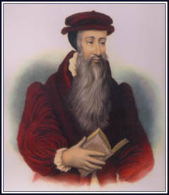
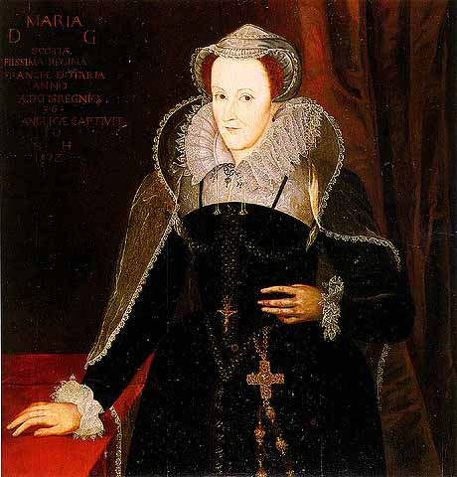

Slide 4
Ye interpret the Scriptures in one manner, and [the Pope and his cardinals] in another; whom shall I believe and who shall judge? (Mary [Stuart], Queen of Scots, to John Knox as recorded in his The History of the Reformation of the Church of Scotland)
Believe God, that plainly speaketh in His Word: and further than the word teacheth you, ye shall neither believe the one nor the other. The Word of God is plain in itself; and if there appear any obscurity in one place, the Holy ghost, which is never contrarious to Himself, explains the same more clearly in other places. (Question by (Mary [Stuart], Queen of Scots, and answer by John Knox as recorded in his The History of the Reformation of the Church of Scotland)

Slide 5
… if he refuse to hear the church also, let him be unto thee as the Gentile and the publican. (Matthew 18:17b, ASV)
“… hear the church…” (frequent sermon text of members of the Tractarian movement)
“ … if he refuse to hear the church also, let him…” (retaliatory sermon text by Richard Whately, Anglican Archbishop of Dublin)

Slide 6
Behold, I make all things new. (Revelation 21:5b, RSV)

Slide 7
And he gave to Moses, when he had finished speaking with him on Mount Sinai, the two tablets of the testimony, tablets of stone, written with the finger of God. (Exodus 31:18, ESV)
And the Lord gave me the two tablets of stone written with the finger of God … (Deuteronomy 9:10a, ESV)
Immediately the fingers of a human hand appeared and wrote on the plaster of the wall of the king's palace, opposite the lampstand. And the king saw the hand as it wrote … “but the God in whose hand is your breath, and whose are all your ways, you have not honored. Then from his presence the hand was sent, and this writing was inscribed.” (Daniel 5:5, 23b, 24, ESV)
When I look at your heavens, the work of your fingers (David writing in Psalms 8:3a, ESV)
The magicians tried by their secret arts to produce gnats, but they could not. So there were gnats on man and beast. Then the magicians said to Pharaoh, “This is the finger of God.” (Exodus 8:18, 19a, ESV)
But if it is by the finger of God that I cast out demons, then the kingdom of God has come upon you. (Luke 11:20 ESV)

Slide 8
And out of the ground the Lord God made to spring up every tree that is pleasant to the sight and good for food. The tree of life was in the midst of the garden, and the tree of the knowledge of good and evil. (Genesis 2:9, ESV)
Then the Lord God said, “Behold, the man has become like one of us in knowing good and evil. Now, lest he reach out his hand and take also of the tree of life and eat, and live forever-” (Genesis 3:22, ESV)
He drove out the man, and at the east of the garden of Eden he placed the cherubim and a flaming sword that turned every way to guard the way to the tree of life. (Genesis 3:24, ESV)

Slide 9
[Wisdom] is a tree of life to those who lay hold of her; those who hold her fast are called blessed. (Proverbs 3:18, ESV)
The fruit of the righteous is a tree of life, and whoever captures souls is wise. (Proverbs 11:29, ESV)
Hope deferred makes the heart sick, but a desire fulfilled is a tree of life. (Proverbs 13:12, ESV)
A gentle tongue is a tree of life, but perverseness in it breaks the spirit.
(Proverbs 15:4, ESV)

Slide 10
To the one who conquers I will grant to eat of the tree of life, which is in the paradise of God. (Revelation 2:7, ESV)
… the river of the water of life, bright as crystal, flowing from the throne of God and of the Lamb through the middle of the street of the city; also, on either side of the river, the tree of life with its twelve kinds of fruit, yielding its fruit each month. The leaves of the tree were for the healing of the nations. (Revelation 22:1b, 2, ESV)
Blessed are those who wash their robes, so that they may have the right to the tree of life and that they may enter the city by the gates. (Revelation 22:14, ESV)
and if anyone takes away from the words of the book of this prophecy, God will take away his share in the tree of life and in the holy city, which are described in this book. (Revelation 22:19, ESV)

Slide 11
Understanding The Bible
The Purpose of the Bible
The Land of the Bible
The Story of the Bible – Old Testament
The Story of the Bible – New Testament
The Message of the Bible
The Authority of the Bible
The Interpretation of the Bible
Introduction + The Enlightenment of the Holy Spirit
The Christian's Disciplined Study
The Teaching of the Church
The Natural Sense
The Original Sense
The General Sense (part 1)
The General Sense (part 2)
The Use of the Bible
__________________________________________________________________________________________________________________________________
ALL WORD NOTES AND POWERPOINT PRESENTATIONS ARE AVAILABLE AT www.BethlehemChristian.org/bible

