Slide 1
Understanding The Bible
The Purpose of the Bible
The Land of the Bible
The Story of the Bible – Old Testament
The Story of the Bible – New Testament
The Message of the Bible
The Authority of the Bible
The Interpretation of the Bible
Introduction + The Enlightenment of the Holy Spirit
The Christian's Disciplined Study
The Teaching of the Church
The Natural Sense
The Original Sense
The General Sense (part 1)
The General Sense (part 2)
The Use of the Bible
__________________________________________________________________________________________________________________________________
ALL WORD NOTES AND POWERPOINT PRESENTATIONS ARE AVAILABLE AT www.BethlehemChristian.org/bible

Slide 2
As we read the Bible we need to ask ourselves:
Who was the writer and to whom was he writing?
What was the cultural-historical setting of the writer?
What was the meaning of the words in the writer’s day?
What was the intended meaning of the author and why was he saying it?
What should this mean to me in my situation today?

Slide 3
²⁸For we maintain that a man is justified by faith apart from observing the law. (Romans 3:28).
¹What then shall we say that Abraham, our forefather, discovered in this matter? ²If, in fact, Abraham was justified by works, he had something to boast about—but not before God. ³What does the Scripture say? "Abraham believed God, and it was credited to him as righteousness."
(Romans 4:1-3)

Slide 4
²¹Was not our ancestor Abraham considered righteous for what he did when he offered his son Isaac on the altar? ²²You see that his faith and his actions were working together, and his faith was made complete by what he did. ²³And the scripture was fulfilled that says, "Abraham believed God, and it was credited to him as righteousness, "and he was called God's friend. ²⁴You see that a person is justified by what he does and not by faith alone.
(James 2:21-24)

Slide 5
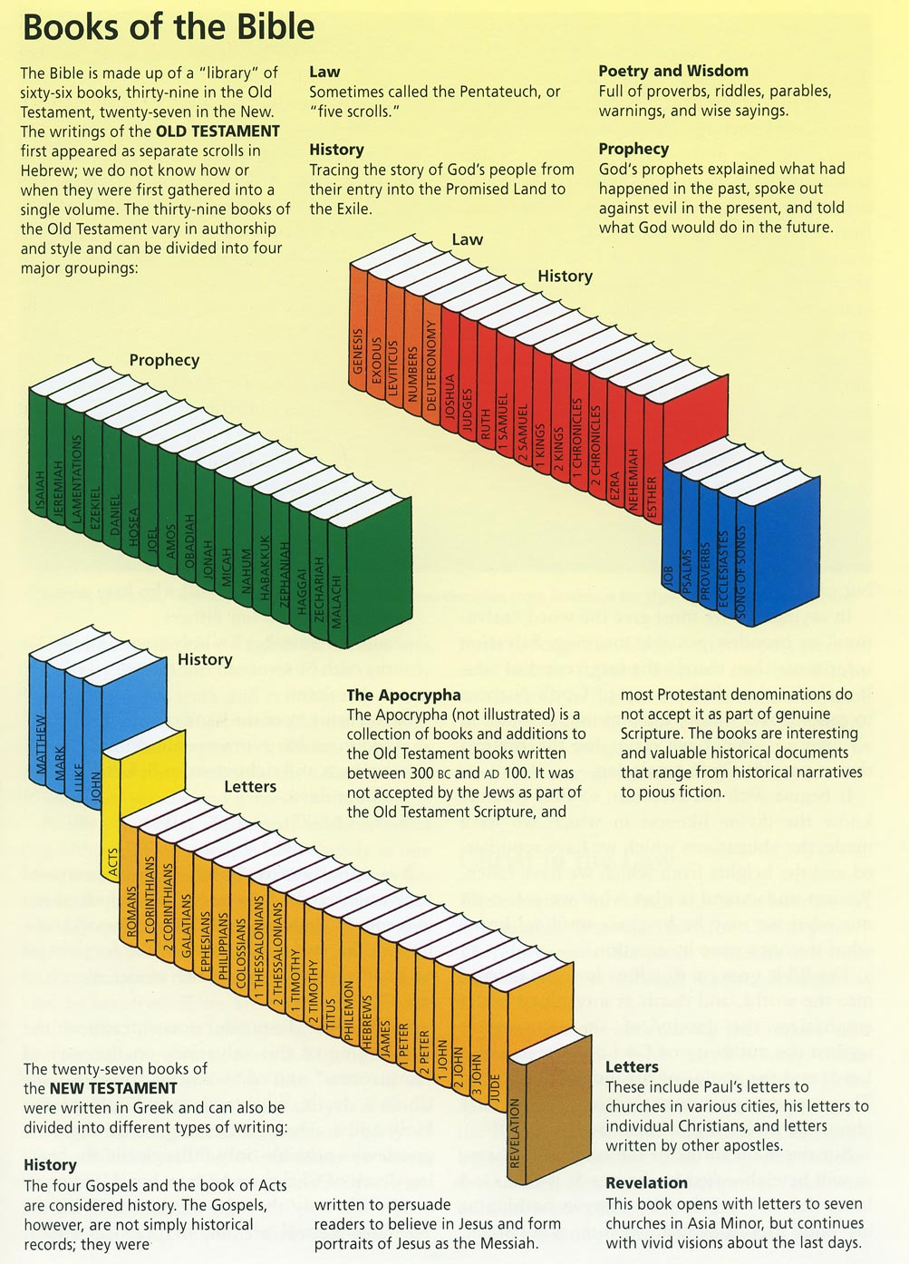
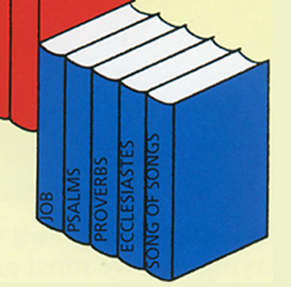

Slide 6
Stott gives as an example the Greek word ataktos. In his two letters to the Thessalonians Paul several times refers to those he describes as ataktos. In classical Greek the word was commonly used of soldiers who broke rank, of an army in disarray. So the Authorized Version translates the word “disorderly,” and it was assumed that there was an undisciplined group of some kind in the Thessalonian church.

Slide 7
¹⁴And we urge you, brothers, warn those who are idle, encourage the timid, help the weak, be patient with everyone.
( 1 Thess. 5:14)

Slide 8
¹²When he had finished washing their feet, he put on his clothes and returned to his place. "Do you understand what I have done for you?" he asked them. ¹³"You call me 'Teacher' and 'Lord,' and rightly so, for that is what I am. ¹⁴Now that I, your Lord and Teacher, have washed your feet, you also should wash one another's feet. ¹⁵I have set you an example that you should do as I have done for you. ¹⁶I tell you the truth, no servant is greater than his master, nor is a messenger greater than the one who sent him. ¹⁷Now that you know these things, you will be blessed if you do them. (John 13:12-17)
¹⁴Greet one another with a kiss of love. Peace to all of you who are in Christ. (1 Peter 5:14)

Slide 9
¹⁰For this reason, and because of the angels, the woman ought to have a sign of authority on her head.
(1 Cor. 11:10)

Slide 10
Understanding The Bible
The Purpose of the Bible
The Land of the Bible
The Story of the Bible – Old Testament
The Story of the Bible – New Testament
The Message of the Bible
The Authority of the Bible
The Interpretation of the Bible
Introduction + The Enlightenment of the Holy Spirit
The Christian's Disciplined Study
The Teaching of the Church
The Natural Sense
The Original Sense
The General Sense (part 1)
The General Sense (part 2)
The Use of the Bible
__________________________________________________________________________________________________________________________________
ALL WORD NOTES AND POWERPOINT PRESENTATIONS ARE AVAILABLE AT www.BethlehemChristian.org/bible

