Slide 1
Understanding The Bible
The Purpose of the Bible
The Land of the Bible
The Story of the Bible – Old Testament
The Story of the Bible – New Testament
The Message of the Bible
The Authority of the Bible
The Interpretation of the Bible
Introduction + The Enlightenment of the Holy Spirit
The Christian's Disciplined Study
The Teaching of the Church
The Natural Sense
The Original Sense
The General Sense (part 1)
The General Sense (part 2)
The Use of the Bible
__________________________________________________________________________________________________________________________________
ALL WORD NOTES AND POWERPOINT PRESENTATIONS ARE AVAILABLE AT www.BethlehemChristian.org/bible

Slide 2
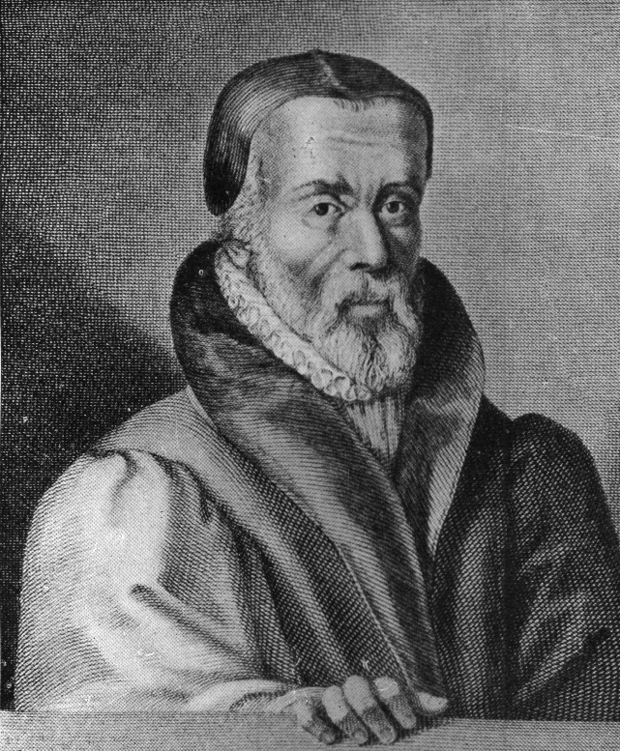

Slide 3
Not long after, Master Tyndale happened to be in the company of a certain divine, recounted for a learned man, and, in communing and disputing with him, he drove him to that issue, that the said great doctor burst out into these blasphemous words, "We were better to be without God's laws than the pope's." Master Tyndale, hearing this, full of godly zeal, and not bearing that blasphemous saying, replied, "I defy the pope, and all his laws;" and added, "If God spared him life, ere many years he would cause a boy that driveth the plough to know more of the Scripture than he did." (Foxe’s Book of Martyrs, Chapter 12 “William Tyndale”)

Slide 4
I also admit the holy Scriptures according to that sense which our holy Mother Church has held, and does hold, to which it belongs to judge of the true sense and interpretation of the Scriptures; neither will I ever take and interpret them otherwise than according to the unanimous consent of the Fathers. (Article 3 of the Profession of Faith from the Council of Trent, 1564)
Individual interpretation of the Scriptures is the right and privilege of all Christians. (Cardinal Principal #5, Bethlehem Christian Church constitution)

Slide 5
And I pray that you, being rooted and established in love, may have power, together with all the saints, to grasp how wide and long and high and deep is the love of Christ, and to know this love that surpasses knowledge (Ephesians 3:17b-19a, NIV)
A recognition of this truth will give us more respect than we customarily have for “tradition”, that is, for the understanding of Biblical truth which has been handed down from the past to the present.

Slide 6
And he gave the apostles, the prophets, the evangelists, the shepherds [pastors] and teachers, to equip the saints for the work of ministry, for building up the body of Christ. (Ephesians 4:11, 12 ESV)
Let the word of Christ dwell in you richly, teaching and admonishing one another in all wisdom (Colossians 3:16a ESV)

Slide 7
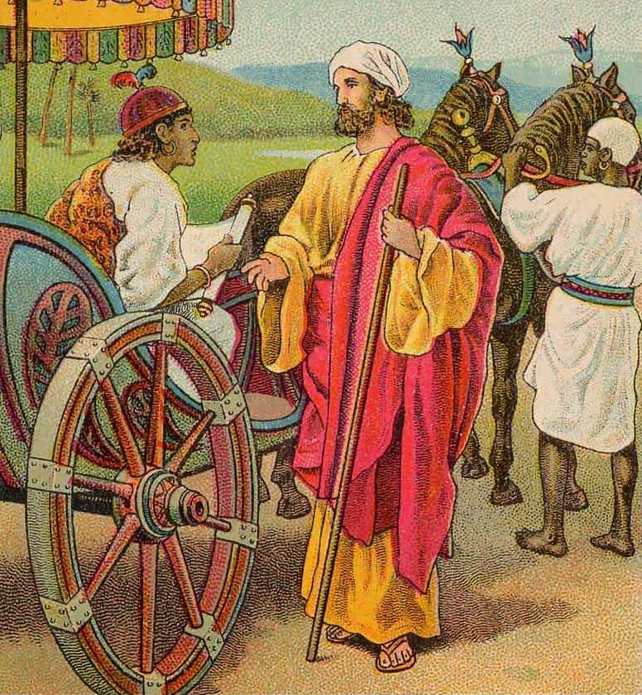
The Ethiopian Converted
.
For with the heart one believes and is justified, and with the mouth one confesses and is saved.
(Romans 10:10)

Slide 8
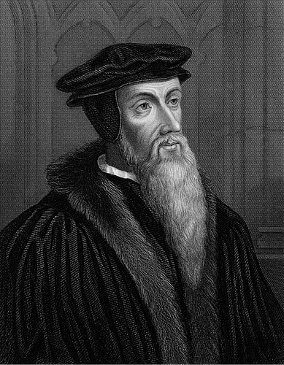

Slide 9
That is also why that the reading of the Scriptures profits so few in this day, because we can scarce find one among a hundred who submits himself willingly to learn. … And if any man, mistrusting himself, submits himself to be taught, the angels shall rather come down from heaven … than the Lord will suffer us to labor in vain; though (as did the eunuch) we must use all helps, which the Lord offers us, for the understanding of the Scriptures. [Fanatics] require inspirations and revelations … from heaven, and, [despise] the minister of God, by whose hand they ought to be governed. Others, who trust too much to their own wit, will … hear no man, and they will read no commentaries. But God will not have us to despise those helps which he offers unto us, and he will not allow those who despise them to go unpunished. And here we must remember, that the Scripture is not only given us, but that interpreters and teachers are also added, to be helps to us. For this cause the Lord sent rather Philip than an angel to the eunuch. (John Calvin, Commentary on Acts 8:31)

Slide 10
But you are not to be called rabbi, for you have one teacher, and you are all brothers. And call no man your father on earth, for you have one Father, who is in heaven. Neither be called instructors, for you have one instructor, the Christ. (Matthew 23:8-10 ESV)
I write these things to you about those who are trying to deceive you. But the anointing that you received from him abides in you, and you have no need that anyone should teach you. But as his anointing teaches you about everything, and is true, and is no lie-just as it has taught you, abide in him. (I John 2:26, 27 ESV)

Slide 11
Now these [Berean] Jews were more noble than those in Thessalonica; they received the word with all eagerness, examining the Scriptures daily to see if these things were so. (Acts 17:11 ESV)
Oh how I love your law! It is my meditation all the day. Your commandment makes me wiser than my enemies, for it is ever with me. I have more understanding than all my teachers, for your testimonies are my meditation. (Psalms 119:97-99 ESV)

Slide 12
But we have renounced disgraceful, underhanded ways. We refuse to practice cunning or to tamper with God's word, but by the open statement of the truth we would commend ourselves to everyone's conscience in the sight of God. (II Corinthians 4:2 ESV)
There are some things in [Paul’s letters] that are hard to understand, which the ignorant and unstable twist to their own destruction, as they do the other Scriptures. (II Peter 3:16b ESV)

Slide 13
Understanding The Bible
The Purpose of the Bible
The Land of the Bible
The Story of the Bible – Old Testament
The Story of the Bible – New Testament
The Message of the Bible
The Authority of the Bible
The Interpretation of the Bible
Introduction + The Enlightenment of the Holy Spirit
The Christian's Disciplined Study
The Teaching of the Church
The Natural Sense
The Original Sense
The General Sense (part 1)
The General Sense (part 2)
The Use of the Bible
__________________________________________________________________________________________________________________________________
ALL WORD NOTES AND POWERPOINT PRESENTATIONS ARE AVAILABLE AT www.BethlehemChristian.org/bible

