Slide 1
Understanding The Bible
The Purpose of the Bible
The Land of the Bible
The Story of the Bible – Old Testament
The Story of the Bible – New Testament
The Message of the Bible
6. The Authority of the Bible
Three definitions
Three Disclaimers
Arguments for the authority of Scripture
Christ’s view of the Old Testament
Christ’s provision for the New Testament
The Apostles’ authority confirmed
Some conclusions
7. The Interpretation of the Bible
8. The Use of the Bible
__________________________________________________________________________________________________________________________________
ALL WORD NOTES AND POWERPOINT PRESENTATIONS ARE AVAILABLE AT www.BethlehemChristian.org/bible

Slide 2
Alternative 1: Jesus was correct in the view He presented about the authority of Scripture
Alternative 2: Jesus was not correct in the view He presented about the authority of Scripture
Alternative 2a: Jesus did not know he was wrong about the authority of Scripture, but just believed like His contemporaries (kenosis theory)
Alternative 2b: Jesus did know he was wrong about the authority of Scripture, but said what He did because of the way His audience viewed Scripture (accommodation theory)

Slide 3
Is it compatible with intellectual integrity to accept the unique authority of Scripture when so many residual problems [literary, historical, theological, and moral] remain? Yes, indeed it is.

Slide 4
You call me Teacher and Lord, and you are right, for so I am.
(John 13:13 ESV)

Slide 5
If Jesus Christ is truly out teacher and our Lord, we are under both His instruction and His authority. We must therefore bring our mind into subjection to Him as our teacher and our will into subjection to Him as our Lord. We have no liberty to disagree with Him or to disobey him.

Slide 8
{1}“At [the Council of Nicea in 325 A.D.],” [religious historian Sir Leigh] Teabing said, “many aspects of Christianity were debated and voted upon―the date of Easter, the role of the bishops, the administration of sacraments, and, of course, the divinity of Jesus.”
[Sophie] “I don’t follow. His divinity?”
“My dear, Teabing declared, “until that moment in history, Jesus was viewed by His followers as a mortal prophet … a great and powerful man but a man nonetheless. A mortal.”
“Not the son of God?”
“Right,” Teabing said. “Jesus establishment as ‘the Son of God’ was officially proposed and voted on by the Council of Nicea.”
“Hold on. You’re saying that Jesus’ divinity was the result of a vote?”
“A relatively close one at that,” Teabing added. (The Da Vinci Code, page 233)

Slide 9
{2}Understandably, [Jesus’] life was recorded by thousands of followers across the land …
“More than eighty gospels were considered for the New Testament, and yet only a relatively few were chosen for inclusion―Matthew, Mark, Luke, and John among them.
“Who chose which gospels to include?” Sophie asked.
“Aha!” Teabing burst with enthusiasm. “The fundamental irony of Christianity! The Bible, as we know it today, was collated by the pagan Roman emperor Constantine the Great” (The Da Vinci Code, page 231)

Slide 10
{3}“The bible is a product of man, my dear. Not of God. The Bible did not fall magically from the clouds. Man created it as a historical record of tumultuous times, and it has evolved through countless, translations, additions, and revisions. History has never had a definitive version of the book” (The Da Vinci Code, page 231)

Slide 11
{4}FACT
“All descriptions of artwork, architecture, documents, and secret rituals in this novel are accurate.”
(The Da Vinci Code, page 1)

Slide 13
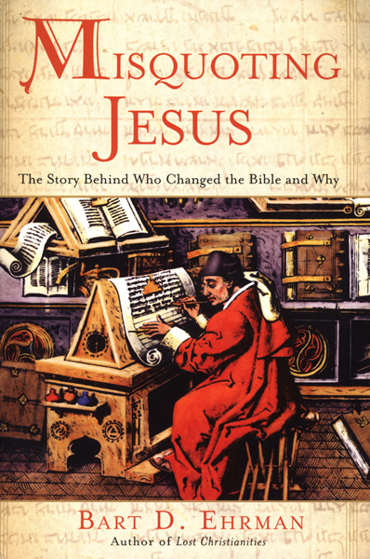

Slide 14
{5}There are more variations among our manuscripts than there are words in the New Testament.” (Misquoting Jesus, page 90)
Elsewhere Ehrman states that the number of variants is as high as 400,000. (Misquoting Jesus, page 89)

Slide 15
{6}In some instances, the very meaning of the text is at stake, depending on how one resolves a textual problem: Was Jesus an angry man [Mark 1:41]? Was he completely distraught in the face of death [Heb 2:8–9]? Did he tell his disciples that they could drink poison without being harmed [Mark 16:9–20]? Did he let an adulteress off the hook with nothing but a mild warning [John 7:53–8:11]? Is the doctrine of the Trinity explicitly taught in the New Testament [1 John 5:7–8]? Is Jesus actually called “the unique God” there [John 1:18]? Does the New Testament indicate that even the Son of God himself does not know when the end will come [Matt 24:36]? The questions go on and on, and all of them are related to how one resolves difficulties in the manuscript tradition as it has come down to us. (Misquoting Jesus, page 208)

Slide 16
Understanding The Bible
The Purpose of the Bible
The Land of the Bible
The Story of the Bible – Old Testament
The Story of the Bible – New Testament
The Message of the Bible
6. The Authority of the Bible
Three definitions
Three Disclaimers
Arguments for the authority of Scripture
Christ’s view of the Old Testament
Christ’s provision for the New Testament
The Apostles’ authority confirmed
Some conclusions
7. The Interpretation of the Bible
8. The Use of the Bible
__________________________________________________________________________________________________________________________________
ALL WORD NOTES AND POWERPOINT PRESENTATIONS ARE AVAILABLE AT www.BethlehemChristian.org/bible

