Slide 1
Understanding The Bible
The Purpose of the Bible
The Land of the Bible
The Story of the Bible – Old Testament
The Story of the Bible – New Testament
The Message of the Bible
The living and consistent God
Redemption
Adoption
Glorification
6. The Authority of the Bible
7. The Interpretation of the Bible
8. The Use of the Bible
__________________________________________________________________________________________________________________________________
ALL WORD NOTES AND POWERPOINT PRESENTATIONS ARE AVAILABLE AT www.BethlehemChristian.org/bible

Slide 2
For as the lightning comes from the east and shines as far as the west, so will be the coming of the Son of Man.
(Matthew 24:27 ESV)

Slide 3
… we await a Savior, the Lord Jesus Christ, who will transform our lowly body to be like his glorious body
(Phillipians 3:20b, 21a ESV)

Slide 4
But someone will ask, “How are the dead raised? With what kind of body do they come?” You foolish person! What you sow does not come to life unless it dies. And what you sow is not the body that is to be, but a bare kernel, perhaps of wheat or of some other grain.
(I Corinthians 15:35-37 ESV)

Slide 5
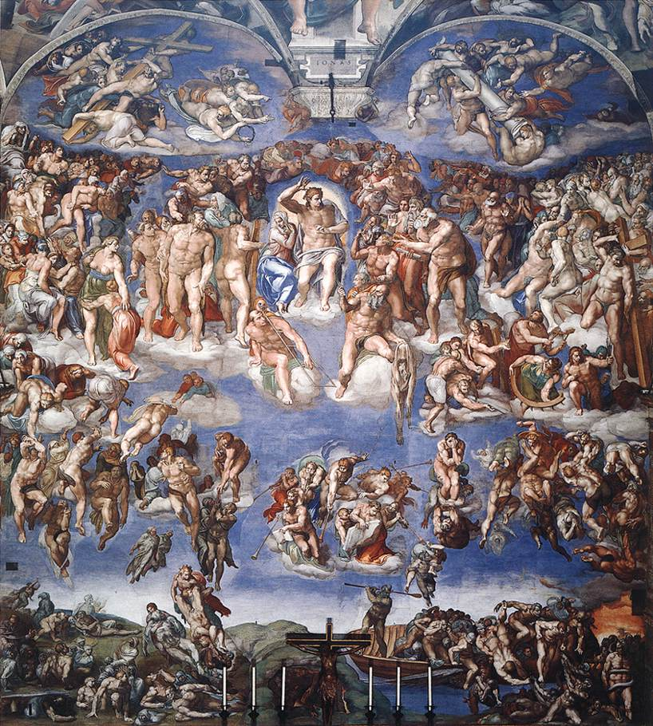

Slide 6
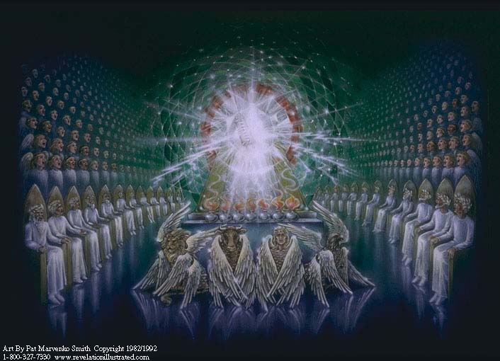

Slide 7
… “Hallelujah! For the Lord our God the Almighty reigns.
(Revelation 19:6 ESV)

Slide 8
… [the servants of God and the Lamb] will reign forever and ever.
(Revelation 22:5 ESV)

Slide 9
Existentialists insist that nothing has meaning any longer, and that therefore no intellectual or moral authority of any kind is left … post-modernism is hostile to all truth claims.

Slide 10
As Christians we confess that Jesus is Lord.
This involves submission to his authority.
This includes a submission to the Bible’s authority.

Slide 11
The contemporary church is confused. The non-Christian world is constantly being treated to the bewildering spectacle of Christians in disagreement and discord. Why is this?

Slide 12
The primary cause of the confusion in the church is the lack of an agreed authority. The church will never recover either its morale or its mission unless it first rediscovers the source of its authority.

Slide 13
Other religions also have their holy books; what is so special about the Christian Scriptures, the Bible?

Slide 14
Understanding The Bible
The Purpose of the Bible
The Land of the Bible
The Story of the Bible – Old Testament
The Story of the Bible – New Testament
The Message of the Bible
The living and consistent God
Redemption
Adoption
Glorification
6. The Authority of the Bible
7. The Interpretation of the Bible
8. The Use of the Bible
__________________________________________________________________________________________________________________________________
ALL WORD NOTES AND POWERPOINT PRESENTATIONS ARE AVAILABLE AT www.BethlehemChristian.org/bible

