Slide 1
Understanding The Bible
The Purpose of the Bible
The Land of the Bible
The Story of the Bible – Old Testament
The Story of the Bible – New Testament
The Message of the Bible
Introduction
The living and consistent God
Redemption
Adoption
Glorification
6. The Authority of the Bible
7. The Interpretation of the Bible
8. The Use of the Bible
__________________________________________________________________________________________________________________________________
ALL WORD NOTES AND POWERPOINT PRESENTATIONS ARE AVAILABLE AT www.BethlehemChristian.org/bible

Slide 2
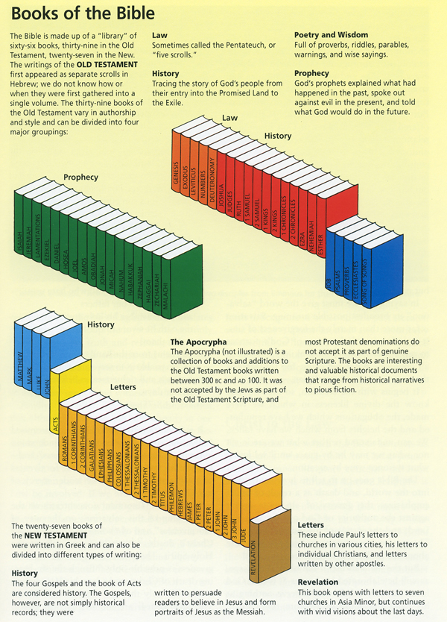

Slide 3
"The answer to such people is that if they cannot understand books written for grown-ups, they should not talk about them“ (C. S. Lewis, Christian Behavior, chapter entitled “Hope”, in Mere Christianity)

Slide 4
I still have many things to say to you, but you cannot bear them now. When the Spirit of truth comes, he will guide you into all the truth, for he will not speak on his own authority, but whatever he hears he will speak, and he will declare to you the things that are to come. He will glorify me, for he will take what is mine and declare it to you. All that the Father has is mine; therefore I said that he will take what is mine and declare it to you.
(John 16:12-15 ESV)

Slide 5
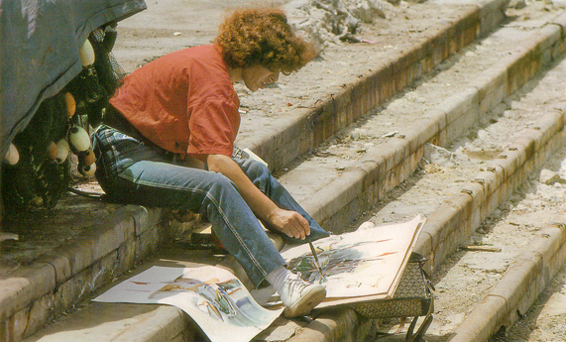
An artist begins by making a sketch, and then applies oils to the canvas bit by bit until the whole picture finally emerges.

Slide 6
Long ago, at many times and in many ways, God spoke to our fathers by the prophets, but in these last days he has spoken to us by his Son
(Hebrews 1:1, 2a ESV)

Slide 7
Bel bows down; Nebo stoops; their idols are on beasts and livestock; these things you carry are borne as burdens on weary beasts. They stoop; they bow down together; they cannot save the burden, but themselves go into captivity. “Listen to me, O house of Jacob, all the remnant of the house of Israel, who have been borne by me from before your birth, carried from the womb; even to your old age I am he, and to gray hairs I will carry you. I have made, and I will bear; I will carry and will save.
(Isaiah 46:1-4 ESV)

Slide 8
Our God is in the heavens; he does all that he pleases. Their idols are silver and gold, the work of human hands. They have mouths, but do not speak; eyes, but do not see. They have ears, but do not hear; noses, but do not smell. They have hands, but do not feel; feet, but do not walk; and they do not make a sound in their throat. Those who make them become like them; so do all who trust in them.
(Psalms 115:3-8 ESV)

Slide 9
Look at the birds of the air: they neither sow nor reap nor gather into barns, and yet your heavenly Father feeds them. … Consider the lilies of the field, how they grow: they neither toil nor spin, yet I tell you, even Solomon in all his glory was not arrayed like one of these.
(Matthew 6:26a, 28b, 29 ESV)

Slide 10
… the Most High rules the kingdom of men and gives it to whom he will.
(Daniel 4:32b ESV)
… in this city there were gathered together against your holy servant Jesus … both Herod and Pontius Pilate, along with the Gentiles and the peoples of Israel, to do whatever your hand and your plan had predestined to take place.
(Acts 4:27b, 28 ESV)

Slide 11
Ah, Assyria, the rod of my anger; the staff in their hands is my fury! Against a godless nation I send him, and against the people of my wrath I command him, to take spoil and seize plunder, and to tread them down like the mire of the streets. (Isaiah 10:5, 6 ESV)
Now I have given all these lands into the hand of Nebuchadnezzar, the king of Babylon, my servant … (Jeremiah 27:6a ESV)
[The Lord, your Redeemer, says of Cyrus, ‘He is my shepherd, and he shall fulfill all my purpose’; (Isaiah 44:28 ESV)

Slide 12
For I the Lord do not change … (Malachi 3:6a ESV)
if we are faithless, [God] remains faithful-for he cannot deny himself. (2 Timothy 2:13, ESV)

Slide 13
For God so loved the world, that he gave his only Son, that whoever believes in him should not perish but have eternal life. (John 3:16 ESV)
… whoever does not obey the Son shall not see life, but the wrath of God remains on him. (John 3:36b ESV)
And you were dead in the trespasses and sins … and were by nature children of wrath, like the rest of mankind. But God, being rich in mercy, because of the great love with which he loved us, even when we were dead in our trespasses, made us alive … (Ephesians 2:1a, 3b-5a ESV)

Slide 14
Grace is love, but love of a special sort. It is love which is kind to the unkind, and generous to the ungrateful and undeserving. Grace is God’s free and unmerited favor, loving the unlovable …

Slide 15
Understanding The Bible
The Purpose of the Bible
The Land of the Bible
The Story of the Bible – Old Testament
The Story of the Bible – New Testament
The Message of the Bible
Introduction
The living and consistent God
Redemption
Adoption
Glorification
6. The Authority of the Bible
7. The Interpretation of the Bible
8. The Use of the Bible
__________________________________________________________________________________________________________________________________
ALL WORD NOTES AND POWERPOINT PRESENTATIONS ARE AVAILABLE AT www.BethlehemChristian.org/bible

