Slide 1
Understanding The Bible
The Purpose of the Bible
The Land of the Bible
The Story of the Bible – Old Testament
The Story of the Bible – New Testament
After the Acts of the Apostles
The Message of the Bible
The Authority of the Bible
The Interpretation of the Bible
The Use of the Bible
__________________________________________________________________________________________________________________________________
ALL WORD NOTES AND POWERPOINT PRESENTATIONS ARE AVAILABLE AT www.BethlehemChristian.org/bible

Slide 2
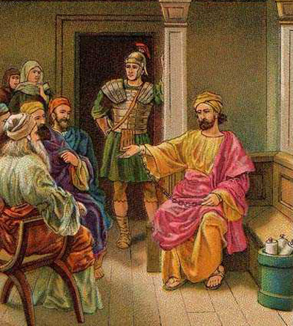

Slide 3
The reason I left you in Crete was that you might straighten out what was left unfinished and appoint elders in every town, as I directed you. (Titus 1:5)

Slide 4
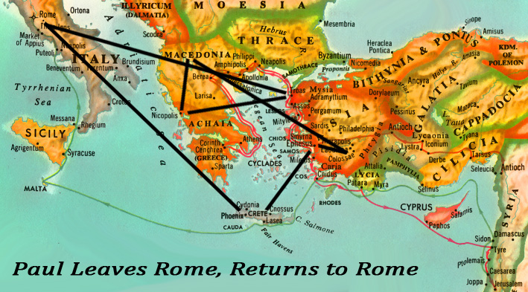
Paul’s Likely sequence of travel following his release from house arrest.

Slide 5
⁶An elder must be blameless, the husband of but one wife, a man whose children believe and are not open to the charge of being wild and disobedient. ⁷Since an overseer is entrusted with God's work, he must be blameless—not overbearing, not quick-tempered, not given to drunkenness, not violent, not pursuing dishonest gain. ⁸Rather he must be hospitable, one who loves what is good, who is self-controlled, upright, holy and disciplined. ⁹He must hold firmly to the trustworthy message as it has been taught, so that he can encourage others by sound doctrine and refute those who oppose it. (Titus 1:6-9).

Slide 6
¹⁰For there are many rebellious people, mere talkers and deceivers, especially those of the circumcision group. (Titus 1:10).
¹²Even one of their own prophets has said, "Cretans are always liars, evil brutes, lazy gluttons." (Titus 1:12).
Let people learn to devote themselves to good works in order to meet urgent needs, so that they may not be unproductive. (Titus 3:14).

Slide 8
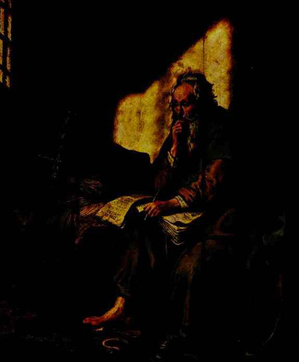

Slide 9
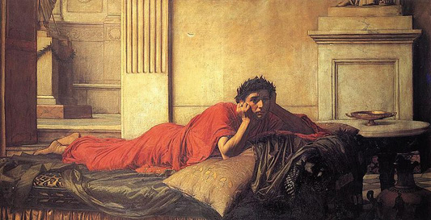
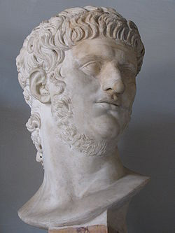
The Remorse of Nero after Killing his Mother by John William Waterhouse, 1878

Slide 10
¹⁷But the Lord stood at my side and gave me strength, so that through me the message might be fully proclaimed and all the Gentiles might hear it. And I was delivered from the lion's mouth.
(2 Timothy 4:17)

Slide 11
⁷I have fought the good fight, I have finished the race, I have kept the faith. ⁸Now there is in store for me the crown of righteousness, which the Lord, the righteous Judge, will award to me on that day—and not only to me, but also to all who have longed for his appearing. (2 Timothy 4:7-8)

Slide 12
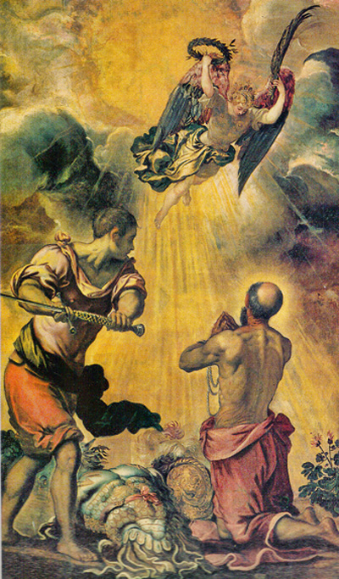
By tradition, Paul was executed by beheading in Rome.

Slide 13
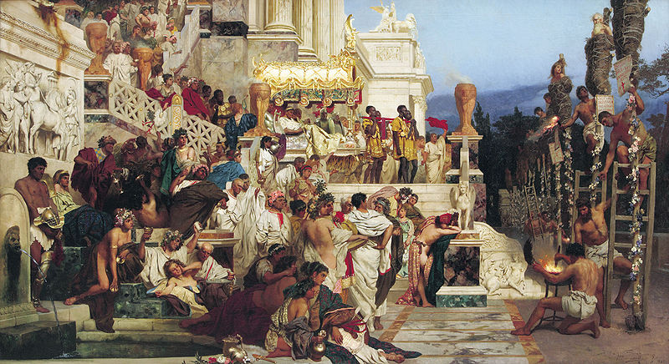
The Torches of Nero, by Henryk Siemiradzki.
According to Tacitus, Nero targeted Christians as those responsible for the fire and ordered Christians to be thrown to dogs, while others were crucified or burned to serve as torch lights.

Slide 14
It's no coincidence that Paul wrote his detailed defense of physical resurrection to the Corinthians, who were immersed in the Greek philosophy of dualism. They'd been taught that the spiritual was incompatible with the physical. But Christ, in his incarnation and resurrection, laid claim not only to the spiritual realm but to the physical as well. His redemption wasn't only of spirits but also of bodies and the earth.
Plato was the first Western philosopher to claim that reality is fundamentally something ideal or abstract. “ To think of the spiritual realm in physical terms or to envision God's presence in the physical world was to do it a disservice. Plato considered the body a liability, not an asset. For Plato ... “the body is a hindrance, as it opposes and even imprisons the soul (Phaedo 65-68; 91-94).”
But according to Scripture, our bodies aren't just shells for our spirits to inhabit; they're a good and essential aspect of our being...
Heaven Appendix A
Randy Alcorn

Slide 15
The Bible and the Book of Revelation end with these words:
¹² “Behold, I am coming soon, bringing my recompense with me, to repay everyone for what he has done. ¹³ I am the Alpha and the Omega, the first and the last, the beginning and the end.”
¹⁴ Blessed are those who wash their robes, so that they may have the right to the tree of life and that they may enter the city by the gates. ¹⁵Outside are the dogs and sorcerers and the sexually immoral and murderers and idolaters, and everyone who loves and practices falsehood.
¹⁶“I, Jesus, have sent my angel to testify to you about these things for the churches. I am the root and the descendant of David, the bright morning star.”
¹⁷ The Spirit and the Bride say, “Come.” And let the one who hears say, “Come.” And let the one who is thirsty come; let the one who desires take the water of life without price.
¹⁸ I warn everyone who hears the words of the prophecy of this book: if anyone adds to them, God will add to him the plagues described in this book, ¹⁹ and if anyone takes away from the words of the book of this prophecy, God will take away his share in the tree of life and in the holy city, which are described in this book.
²⁰ He who testifies to these things says, “Surely I am coming soon.” Amen. Come, Lord Jesus!
²¹ The grace of the Lord Jesus be with all. Amen.

Slide 16
Understanding The Bible
The Purpose of the Bible
The Land of the Bible
The Story of the Bible – Old Testament
The Story of the Bible – New Testament
After the Acts of the Apostles
The Message of the Bible
The Authority of the Bible
The Interpretation of the Bible
The Use of the Bible
__________________________________________________________________________________________________________________________________
ALL WORD NOTES AND POWERPOINT PRESENTATIONS ARE AVAILABLE AT www.BethlehemChristian.org/bible

