Slide 1
Understanding The Bible
The Purpose of the Bible
The Land of the Bible
The Story of the Bible – Old Testament
The Story of the Bible – New Testament
Paul’s Third Missionary Journey
The Message of the Bible
The Authority of the Bible
The Interpretation of the Bible
The Use of the Bible
__________________________________________________________________________________________________________________________________
ALL WORD NOTES AND POWERPOINT PRESENTATIONS ARE AVAILABLE AT www.BethlehemChristian.org/bible

Slide 2
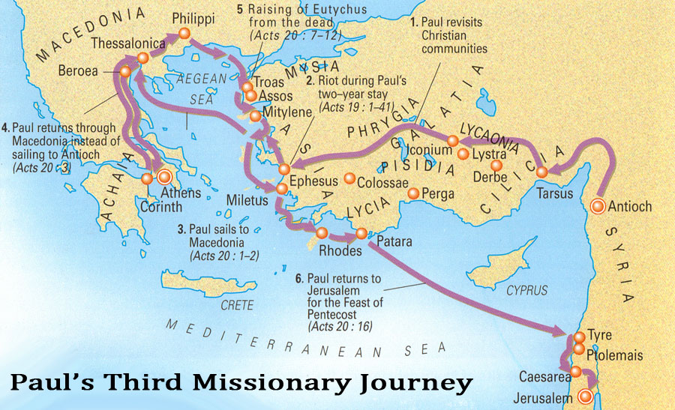

Slide 3
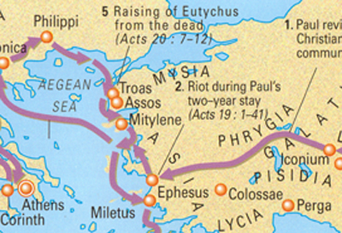

Slide 4
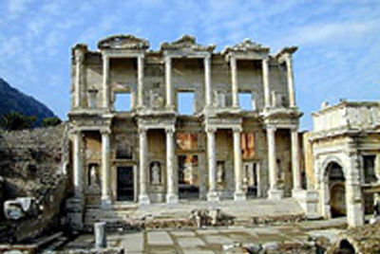
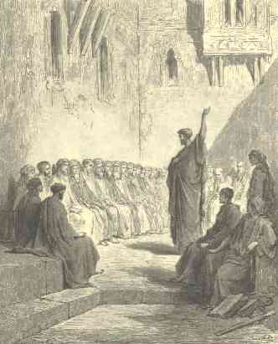

Slide 5
Many of them also who used magic arts brought their books together, and burned them before all men: and they counted the price of them, and found it fifty thousand pieces of silver. Acts 19:19

Slide 6
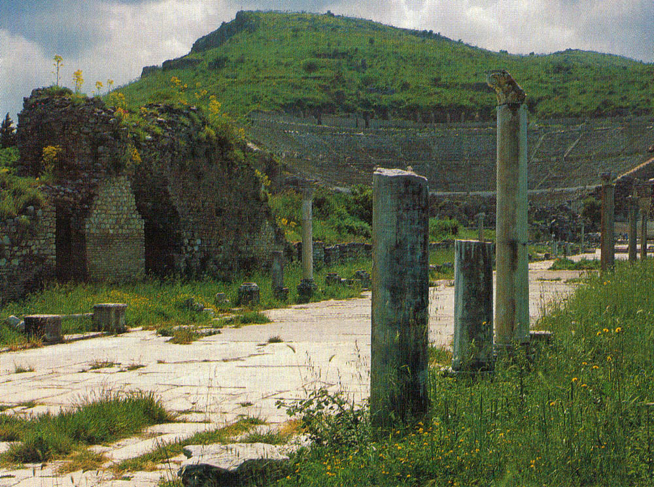
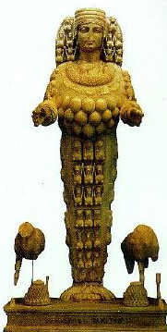
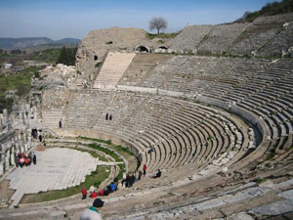
The main street of Ephesus, one of the world’s most thoroughly excavated cities, leading to the theater set in a hillside, to which Paul’s colleagues were dragged. Their preaching hurt sales of Artemis (Diana) figurines (right).

Slide 7
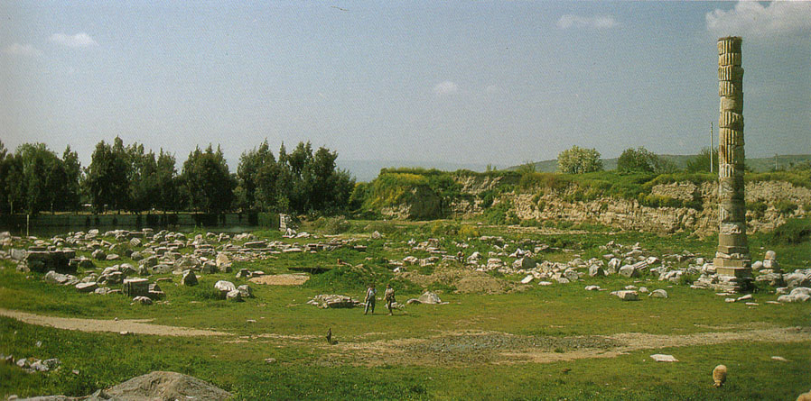
All that remains of the celebrated Temple of Diana (Artemis), one of the Seven Wonders of the Ancient World, at Ephesus. (To get a perspective of the size, notice two people standing front and center.)

Slide 8
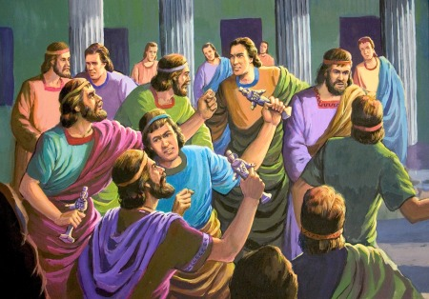

Slide 9
²³ About that time there arose no little disturbance concerning the Way. ²⁴ For a man named Demetrius, a silversmith, who made silver shrines of Artemis, brought no little business to the craftsmen. ²⁵These he gathered together, with the workmen in similar trades, and said, “Men, you know that from this business we have our wealth. ²⁶ And you see and hear that not only in Ephesus but in almost all of Asia this Paul has persuaded and turned away a great many people, saying that gods made with hands are not gods. ²⁷ And there is danger not only that this trade of ours may come into disrepute but also that the temple of the great goddess Artemis may be counted as nothing, and that she may even be deposed from her magnificence, she whom all Asia and the world worship.”
²⁸ When they heard this they were enraged and were crying out, “Great is Artemis of the Ephesians!” ²⁹ So the city was filled with the confusion, and they rushed together into the theater, dragging with them Gaius and Aristarchus, Macedonians who were Paul's companions in travel. ³⁰ But when Paul wished to go in among the crowd, the disciples would not let him. ³¹ And even some of the Asiarchs, who were friends of his, sent to him and were urging him not to venture into the theater. ³²Now some cried out one thing, some another, for the assembly was in confusion, and most of them did not know why they had come together. ³³ Some of the crowd prompted Alexander, whom the Jews had put forward. And Alexander, motioning with his hand, wanted to make a defense to the crowd. ³⁴ But when they recognized that he was a Jew, for about two hours they all cried out with one voice, “Great is Artemis of the Ephesians!”
³⁵ And when the town clerk had quieted the crowd, he said, “Men of Ephesus, who is there who does not know that the city of the Ephesians is temple keeper of the great Artemis, and of the sacred stone that fell from the sky? ³⁶ Seeing then that these things cannot be denied, you ought to be quiet and do nothing rash. ³⁷ For you have brought these men here who are neither sacrilegious nor blasphemers of our goddess. ³⁸ If therefore Demetrius and the craftsmen with him have a complaint against anyone, the courts are open, and there are proconsuls. Let them bring charges against one another. ³⁹ But if you seek anything further, it shall be settled in the regular assembly. ⁴⁰ For we really are in danger of being charged with rioting today, since there is no cause that we can give to justify this commotion.” ⁴¹ And when he had said these things, he dismissed the assembly. Acts 19:23-40

Slide 11
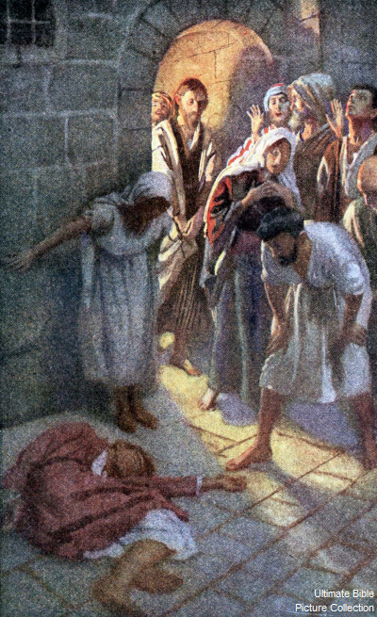

Slide 13
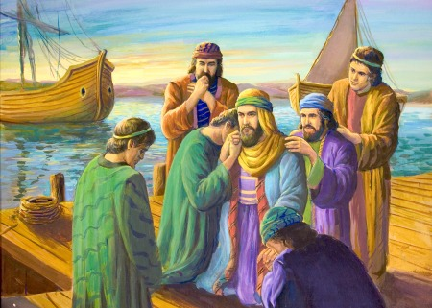

Slide 14
Understanding The Bible
The Purpose of the Bible
The Land of the Bible
The Story of the Bible – Old Testament
The Story of the Bible – New Testament
Paul’s Third Missionary Journey
The Message of the Bible
The Authority of the Bible
The Interpretation of the Bible
The Use of the Bible
__________________________________________________________________________________________________________________________________
ALL WORD NOTES AND POWERPOINT PRESENTATIONS ARE AVAILABLE AT www.BethlehemChristian.org/bible

