Slide 1
Understanding The Bible
The Purpose of the Bible
The Land of the Bible
The Story of the Bible – Old Testament
The Story of the Bible – New Testament
Paul’s Second Missionary Journey
The Message of the Bible
The Authority of the Bible
The Interpretation of the Bible
The Use of the Bible
__________________________________________________________________________________________________________________________________
ALL WORD NOTES AND POWERPOINT PRESENTATIONS ARE AVAILABLE AT www.BethlehemChristian.org/bible

Slide 2
LETTER FROM THE JERUSALEM COUNCIL (A. D. 49) TO GENTILE BELIEVERS
Since we have heard that some persons have gone out from us and troubled you with words, unsettling your minds, although we gave them no instructions, it has seemed good to us, having come to one accord, to choose men and send them to you with our beloved Barnabas and Paul, men who have risked their lives for the sake of our Lord Jesus Christ. We have therefore sent Judas and Silas, who themselves will tell you the same things by word of mouth. For it has seemed good to the Holy Spirit and to us to lay on you no greater burden than these requirements: that you abstain from what has been sacrificed to idols, and from blood, and from what has been strangled, and from sexual immorality. If you keep yourselves from these, you will do well. Farewell. (Acts 15:24-29 ESV)

Slide 3
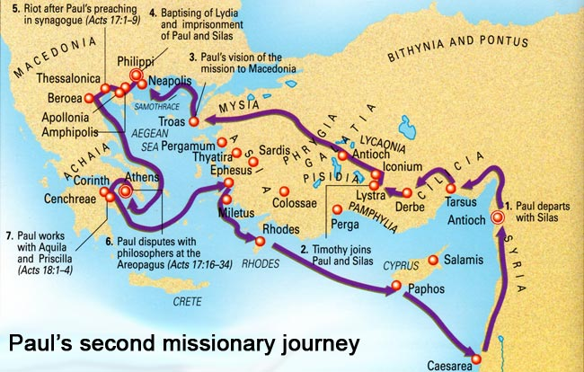

Slide 4
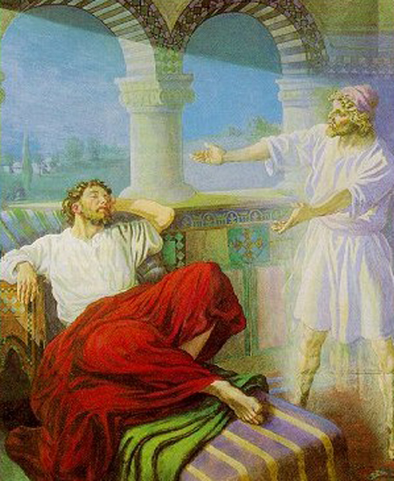

Slide 5
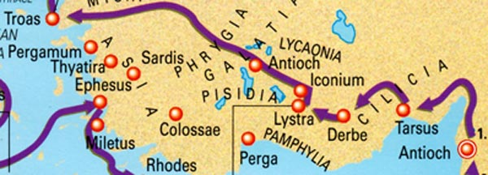

Slide 6
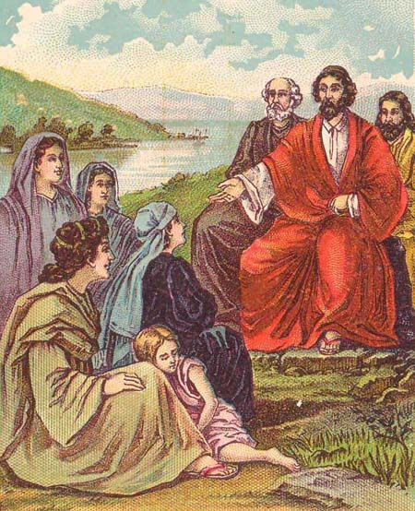

Slide 7
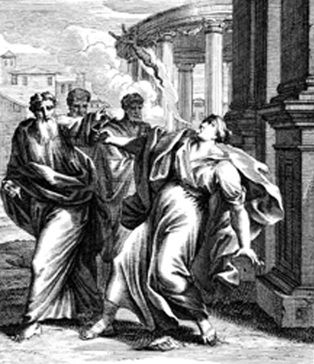

Slide 8
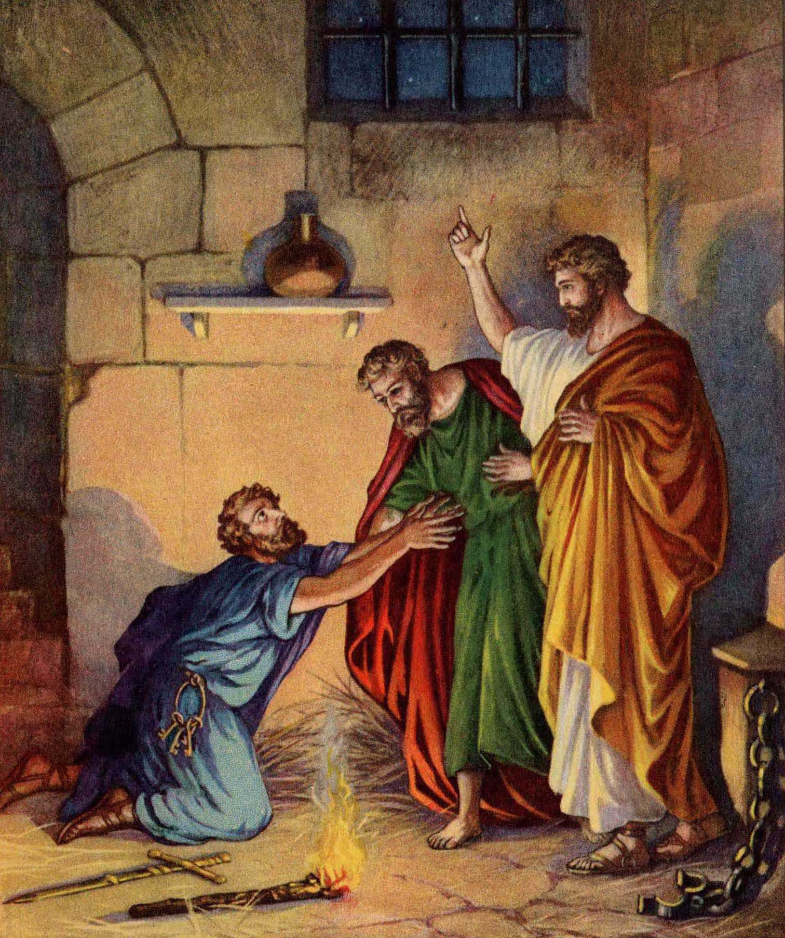

Slide 9
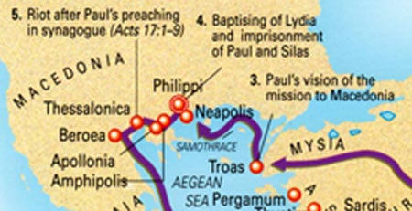

Slide 10
But [other] Jews were jealous, and taking some wicked men of the rabble, they formed a mob, set the city in an uproar, and attacked the house of Jason, seeking to bring them out to the crowd. And when they could not find them, they dragged Jason and some of the brothers before the city authorities, shouting, “These men who have turned the world upside down have come here also, and Jason has received them, and they are all acting against the decrees of Caesar, saying that there is another king, Jesus.” And the people and the city authorities were disturbed when they heard these things. And when they had taken money as security from Jason and the rest, they let them go. The brothers immediately sent Paul and Silas away by night to Berea (Acts 17:5b-10a ESV)

Slide 12
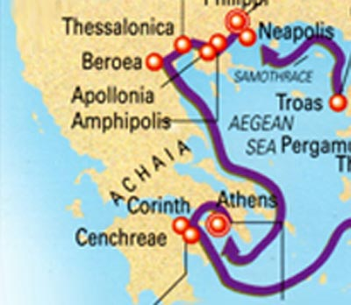

Slide 13
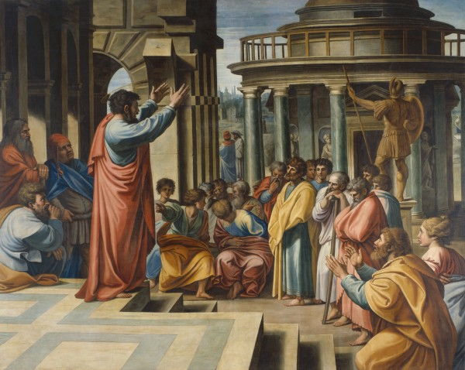

Slide 15
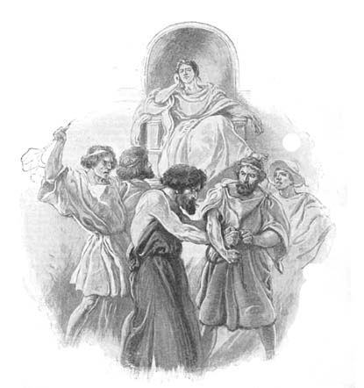

Slide 16
Understanding The Bible
The Purpose of the Bible
The Land of the Bible
The Story of the Bible – Old Testament
The Story of the Bible – New Testament
Paul’s Second Missionary Journey
The Message of the Bible
The Authority of the Bible
The Interpretation of the Bible
The Use of the Bible
__________________________________________________________________________________________________________________________________
ALL WORD NOTES AND POWERPOINT PRESENTATIONS ARE AVAILABLE AT www.BethlehemChristian.org/bible

