Slide 1
Understanding The Bible
The Purpose of the Bible
The Land of the Bible
The Story of the Bible – Old Testament
The Story of the Bible – New Testament
The Death and Resurrection of Jesus
The Message of the Bible
The Authority of the Bible
The Interpretation of the Bible
The Use of the Bible
__________________________________________________________________________________________________________________________________
ALL WORD NOTES AND POWERPOINT PRESENTATIONS ARE AVAILABLE AT www.BethlehemChristian.org/bible

Slide 2
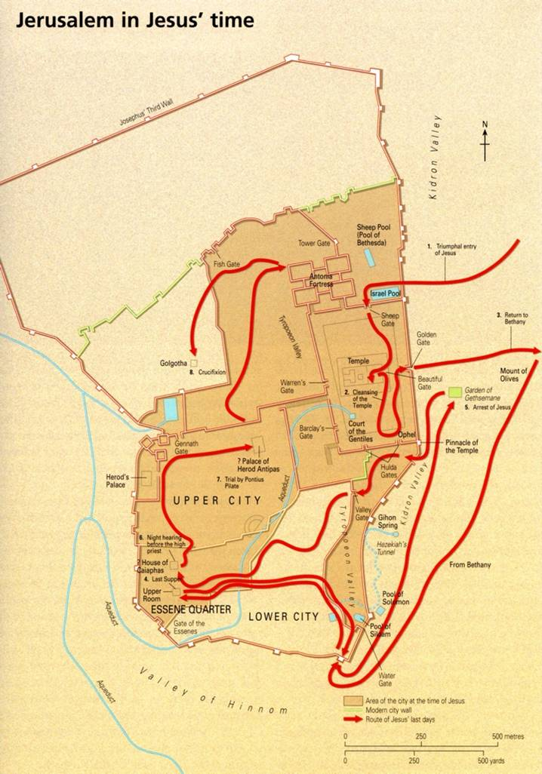

Slide 3
The chief priests and the teachers of the law heard this and began looking for a way to kill him, for they feared him, because the whole crowd was amazed at his teaching. Mark 11:18

Slide 4
²⁷They arrived again in Jerusalem, and while Jesus was walking in the temple courts, the chief priests, the teachers of the law and the elders came to him. ²⁸"By what authority are you doing these things?" they asked. "And who gave you authority to do this?"
²⁹Jesus replied, "I will ask you one question. Answer me, and I will tell you by what authority I am doing these things. ³⁰John's baptism—was it from heaven, or from men? Tell me!"
³¹They discussed it among themselves and said, "If we say, 'From heaven,' he will ask, 'Then why didn't you believe him?' ³²But if we say, 'From men'...." (They feared the people, for everyone held that John really was a prophet.)
³³So they answered Jesus, "We don't know." Jesus said, "Neither will I tell you by what authority I am doing these things." Mark 11:27-33

Slide 5
²⁰Now there were some Greeks among those who went up to worship at the Feast. ²¹They came to Philip, who was from Bethsaida in Galilee, with a request. "Sir," they said, "we would like to see Jesus." ²²Philip went to tell Andrew; Andrew and Philip in turn told Jesus.
²³Jesus replied, "The hour has come for the Son of Man to be glorified. ²⁴I tell you the truth, unless a kernel of wheat falls to the ground and dies, it remains only a single seed. But if it dies, it produces many seeds. ²⁵The man who loves his life will lose it, while the man who hates his life in this world will keep it for eternal life. ²⁶Whoever serves me must follow me; and where I am, my servant also will be. My Father will honor the one who serves me.
²⁷"Now my heart is troubled, and what shall I say? 'Father, save me from this hour'? No, it was for this very reason I came to this hour. ²⁸Father, glorify your name!"
Then a voice came from heaven, "I have glorified it, and will glorify it again." ²⁹The crowd that was there and heard it said it had thundered; others said an angel had spoken to him.
³⁰Jesus said, "This voice was for your benefit, not mine. ³¹Now is the time for judgment on this world; now the prince of this world will be driven out. ³²But I, when I am lifted up from the earth, will draw all men to myself." ³³He said this to show the kind of death he was going to die. John 12:20-33

Slide 6
¹⁰He replied, "As you enter the city, a man carrying a jar of water will meet you. Follow him to the house that he enters, ¹¹and say to the owner of the house, 'The Teacher asks: Where is the guest room, where I may eat the Passover with my disciples?' ¹²He will show you a large upper room, all furnished. Make preparations there.“ Luke 22:10-12

Slide 7
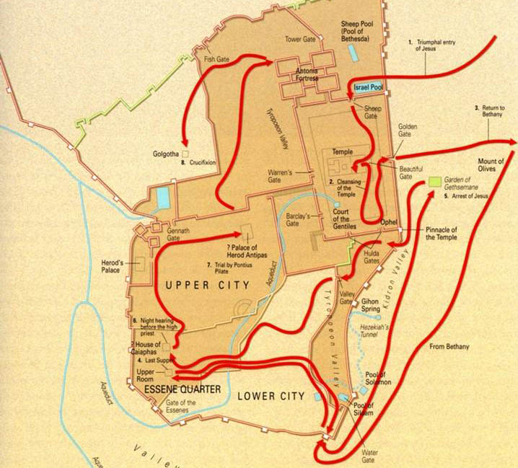

Slide 8
²⁶But you are not to be like that. Instead, the greatest among you should be like the youngest, and the one who rules like the one who serves. Luke 22:26
⁴⁵For even the Son of Man did not come to be served, but to serve, and to give his life as a ransom for many.“ Mark 10:45
“I have eagerly desired to share this Passover with you before I suffer. For I tell you, I will not eat of it again until it finds fulfillment in the Kingdom of God.” Luke 22:15-16

Slide 9
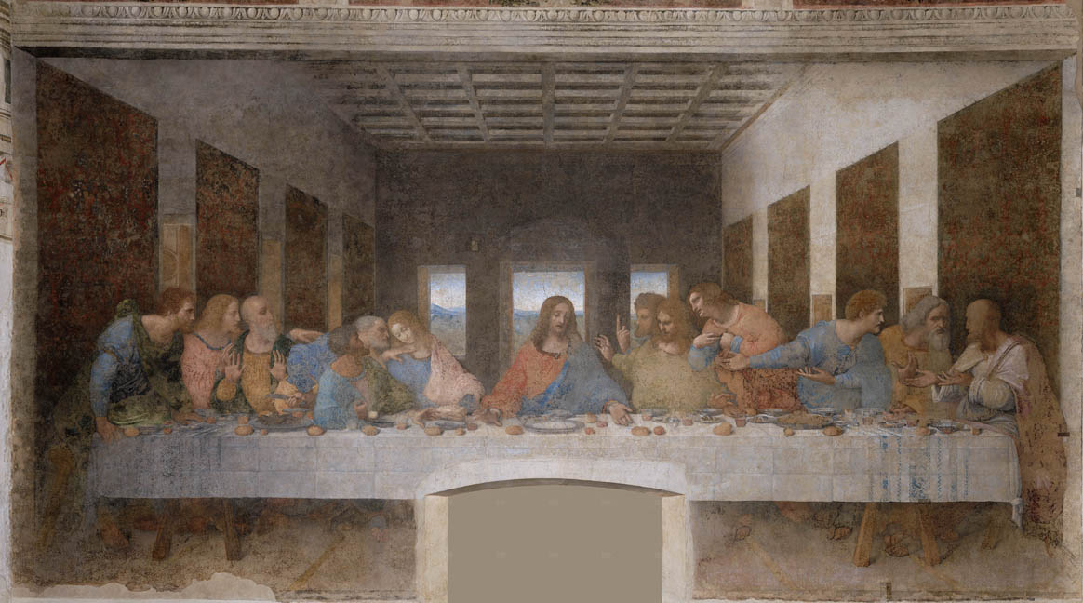

Slide 10
“This is my body, given for you.” Luke 22:19
“This cup is the new covenant in my blood, which is poured out for you.” Luke 22:20
³¹ "The time is coming," declares the LORD, "when I will make a new covenant with the house of Israel and the house of Judah. Jeremiah 31:31

Slide 12
“Are you the Messiah, the Son of the Blessed One?”
Mark 14:61
“I am,” said Jesus. “And you will see the Son of Man sitting at the right hand of the Mighty One and coming on the clouds of heaven.”
Mark 14:62

Slide 14
And Jesus said, “Father, forgive them, for they know not what they do.” And they cast lots to divide his garments. Luke 23:34
26 When Jesus saw his mother and the disciple whom he loved standing nearby, he said to his mother, “Woman, behold, your son!”
27 Then he said to the disciple, “Behold, your mother!” And from that hour the disciple took her to his own home. John 19:26-27
And he said to him, “Truly, I say to you, today you will be with me in Paradise.” Luke 23:43

Slide 15
After this, Jesus, knowing that all was now finished, said (to fulfill the Scripture), “I thirst.” John 19:28
And when the sixth hour had come, there was darkness over the whole land until the ninth hour.
Mark 15:34
And at the ninth hour Jesus cried with a loud voice, “Eloi, Eloi, lema sabachthani?” which means, “My God, my God, why have you forsaken me?” Mark 15:33-34
When Jesus had received the sour wine, he said, “It is finished,” and he bowed his head and gave up his spirit. John 19:30
Then Jesus, calling out with a loud voice, said, “Father, into your hands I commit my spirit!” And having said this he breathed his last. Luke 23:46
​​​​​​​My God, my God, why have you abandoned me? I groan in prayer, but help seems far away. Psalms 22:1b (NET)
Jesus called out with a loud voice, "Father, into your hands I commit my spirit." When he had said this, he breathed his last. Luke 23:46

Slide 16
In their fright the women bowed down with their faces to the ground, but the men said to them, "Why do you look for the living among the dead? ⁶He is not here; he has risen! Remember how he told you, while he was still with you in Galilee.
Luke 24:5-6

Slide 17
¹⁸Then Jesus came to them and said, "All authority in heaven and on earth has been given to me. ¹⁹Therefore go and make disciples of all nations, baptizing them in the name of the Father and of the Son and of the Holy Spirit, ²⁰and teaching them to obey everything I have commanded you. And surely I am with you always, to the very end of the age.“
Matthew 28:18-20

Slide 18
Understanding The Bible
The Purpose of the Bible
The Land of the Bible
The Story of the Bible – Old Testament
The Story of the Bible – New Testament
The Death and Resurrection of Jesus
The Message of the Bible
The Authority of the Bible
The Interpretation of the Bible
The Use of the Bible
__________________________________________________________________________________________________________________________________
ALL WORD NOTES AND POWERPOINT PRESENTATIONS ARE AVAILABLE AT www.BethlehemChristian.org/bible

